Slide 1
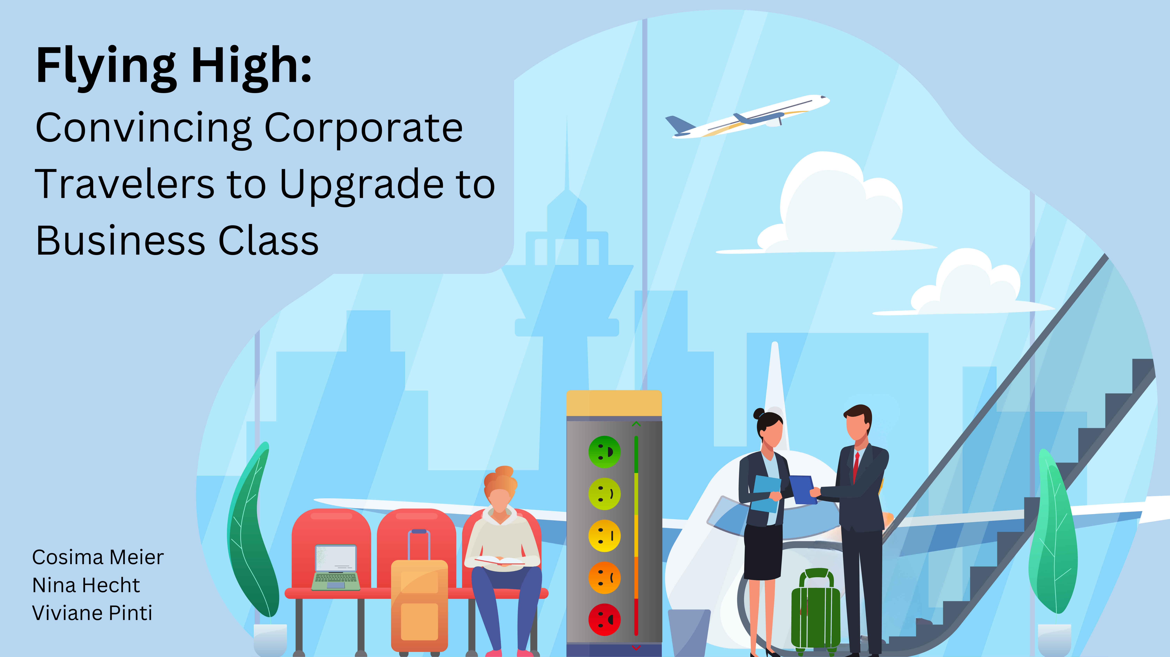
Notes:
Viviane:
Flying High: Convincing Corporate travelers to upgrade to business class
Are you looking to boost passenger satisfaction and increase profits for your airline? Look no further than your business class passengers and potential business class passengers. With 70% of your total profit coming from these passengers, it's clear that they're crucial to your success. With climate change potentially decreasing the number of flights and thereby increasing competition, prioritizing passender satisfaction becomes even more vital.
Evidence shows that Individuals traveling for work are significantly less satisfied in economy class than those traveling for personal reasons. However, business travelers are more satisfied in business class than those traveling for personal reasons. This suggests that the needs of corporate travelers are not being fully met in economy class, but upgrading to business class offers a better experience.
To understand the needs of these valuable customers, we've analysed the 'US Airline passenger satisfaction' dataset. This dataset includes ratings of 14 air travel services as well as additional information about each passenger, such as their class and type of travel.
Cosima:
Our aim is to identify which services should be marketed to corporate travelers flying economy class to convince them to upgrade to business class. By doing so, we can enhance passenger satisfaction and drive profits for your airline.
To determine which airline services to market, we compared passenger satisfaction of the airline services between economy and business class. We evaluated 14 different services and calculated the percentage of passengers who were satisfied or very satisfied (rated 4 or 5 on a scale) in this two classes. Then, we compared the proportions between economy and business class for each service to identify the largest differences.

Slide 2
